Slide 1
ITERATOR Pattern
Having a collection of objects is a very common thing in software development. If we have a collection of objects then we might also find ourselves in need to traverse this collection.
This pattern provides a way to access the elements of an aggregate object sequentially without exposing its underlying representation
Most languages provide traversal techniques over basic collection types. C# also contain some special container types capable of holding a collection of values (example: Lists, and ArrayLists in C#).

Slide 2
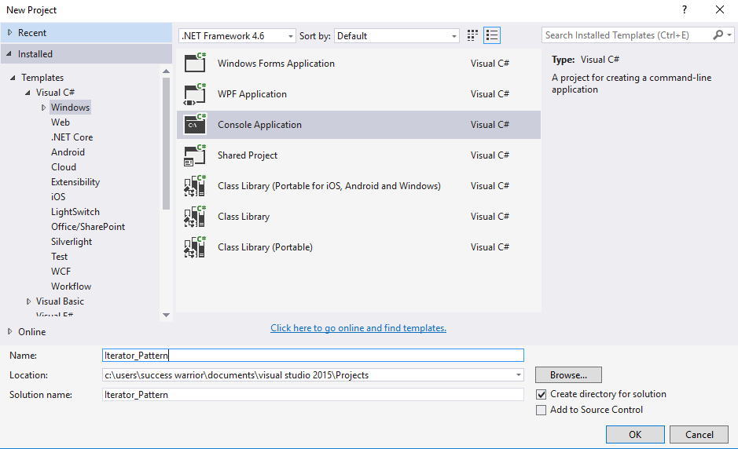

Slide 3
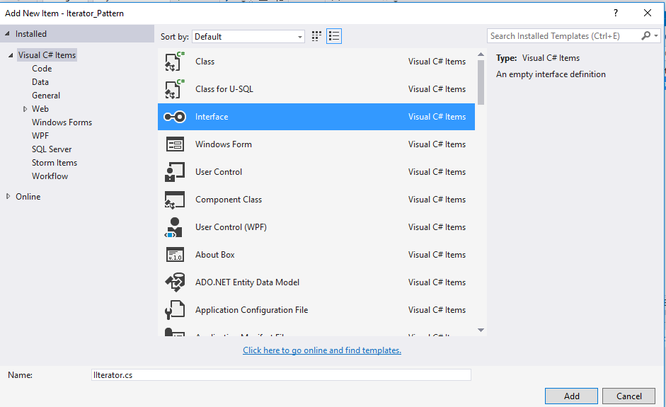

Slide 4
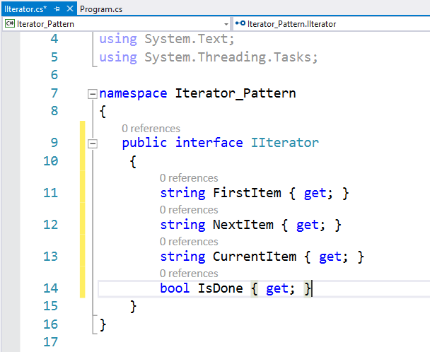

Slide 5


Slide 6
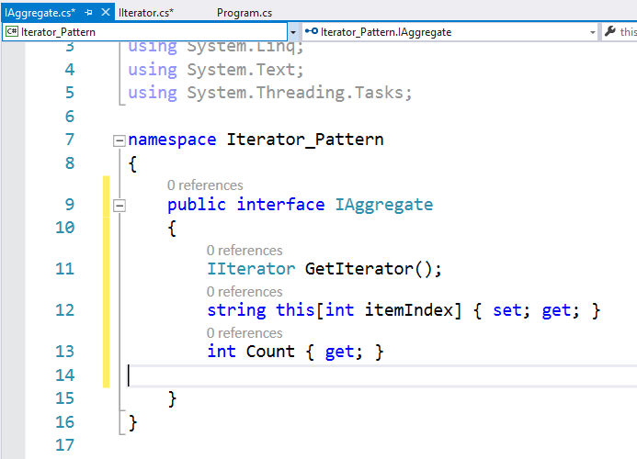

Slide 7
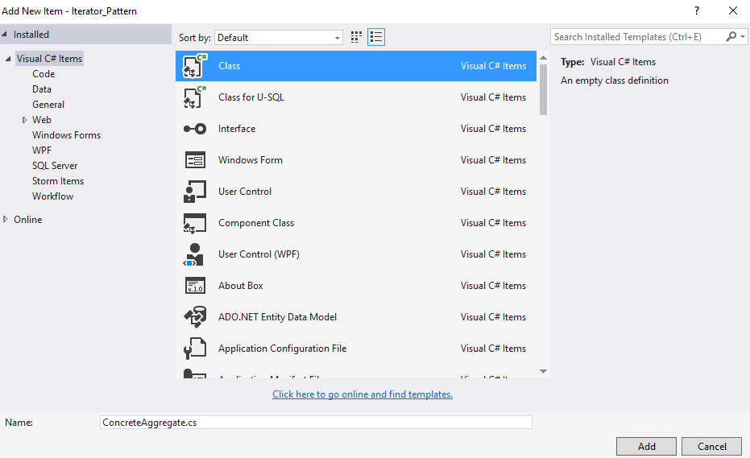

Slide 8
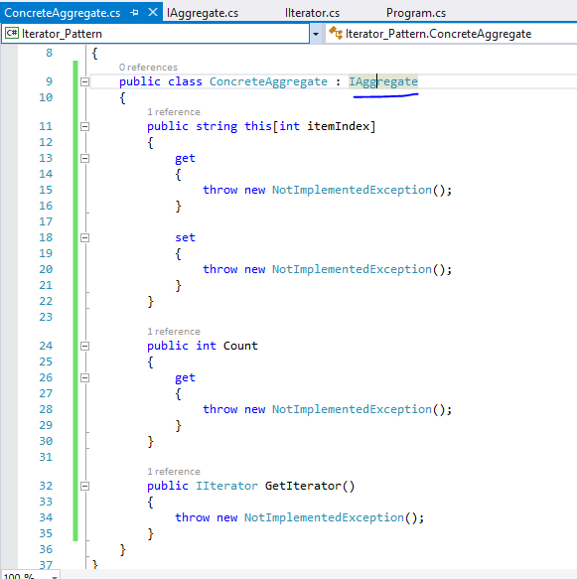
Implement
interface

Slide 9
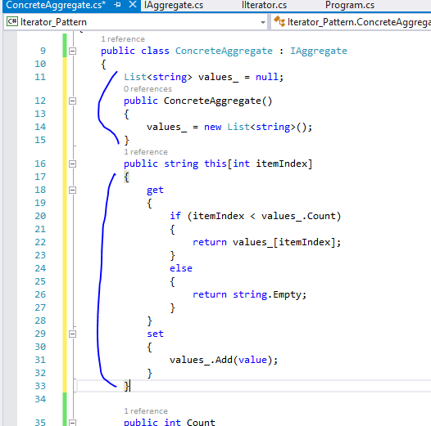

Slide 10
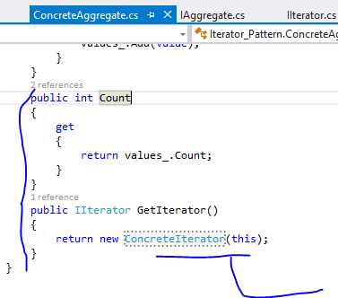
We will create
In next step

Slide 11
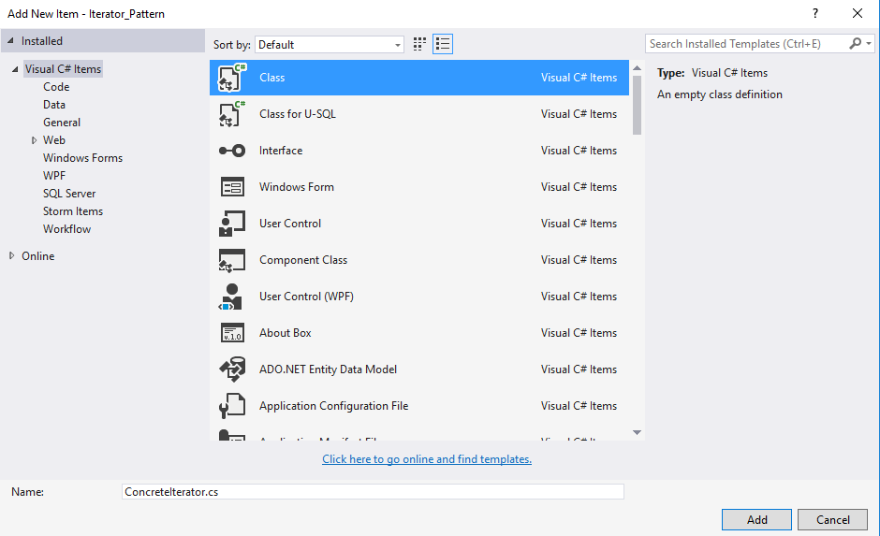

Slide 12
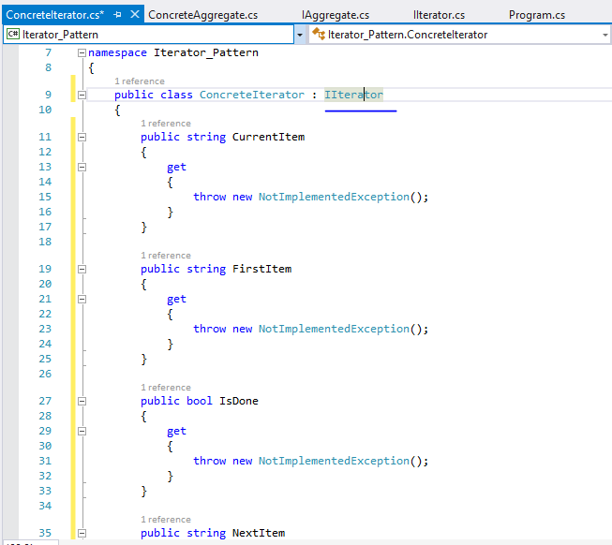
Implement
interface

Slide 13
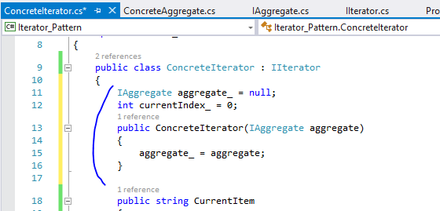

Slide 14
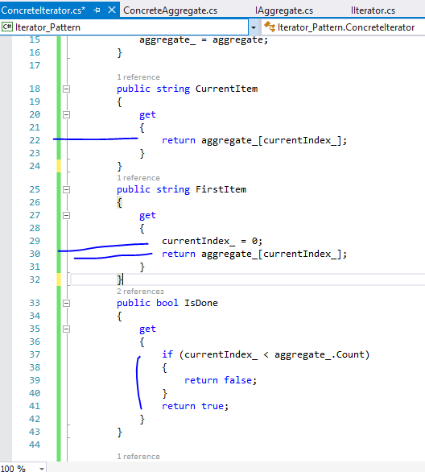

Slide 15
